Slide 1
Nomenclature of heterocycles I. seminar
Assoc. prof., Dr. Maryna M. Kornet
Head, Laboratory of Biotechnology of Physiologically Active Substances; Associate Professor, Department of Chemistry
Zaporizhzhia National University (Zaporizhzhia, Ukraine)
kornetmaryna@ukr.net
19.04.2023
Notes:
Allow me to introduce myself.
I am Marina Kornet, I am a visiting professor here.
Today is my first such experience, so I will be extremely grateful for your support and help.
Today we have an enough important topic for the seminar - the nomenclature of organic compounds.

Slide 2
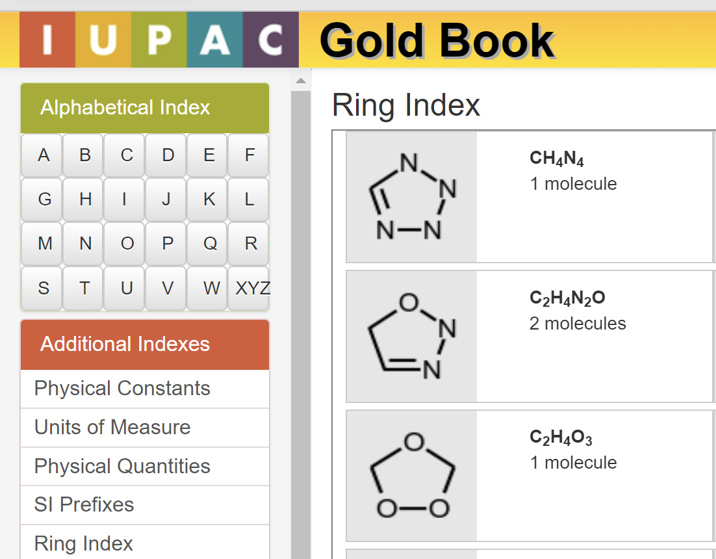
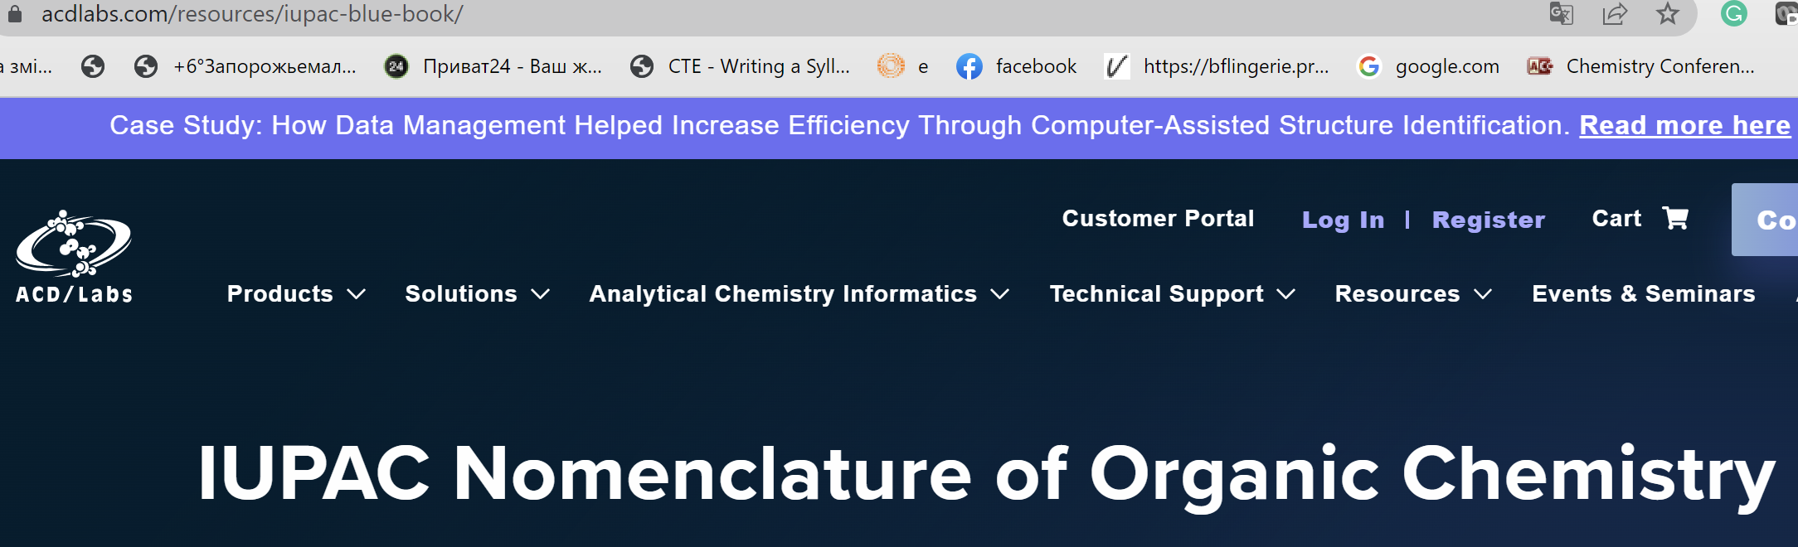
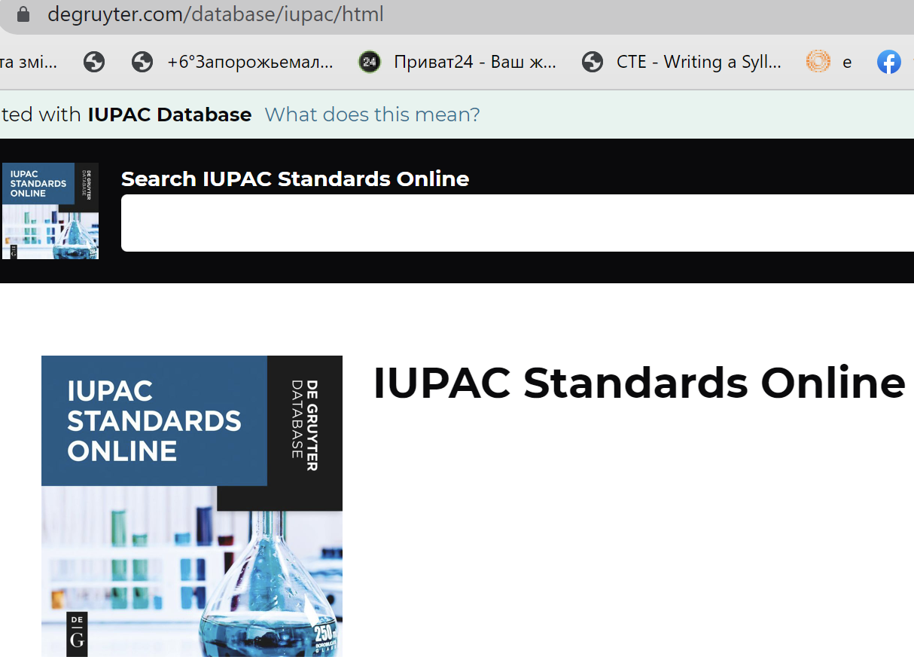
Online Resources
https://goldbook.iupac.org/indexes/rings
https://www.acdlabs.com/resources/iupac-blue-book/
2.11 - The following trivial and semi-trivial names constitute a partial list of such names which are retained for the compound and as a basis of fusion names. The names of the radicals shown are formed according to Rule B-5.
https://www.degruyter.com/database/iupac/html
https://www.acdlabs.com/iupac/nomenclature/79/r79_958.htm
2.12 - The following trivial and semi-trivial names are retained but are not recommended for use in fusion names. The names of the radicals shown are formed according to Rule B-5.
https://www.acdlabs.com/iupac/nomenclature/79/r79_959.htm
Notes:
On this slide, you can see additional resources related to this topic.

Slide 3
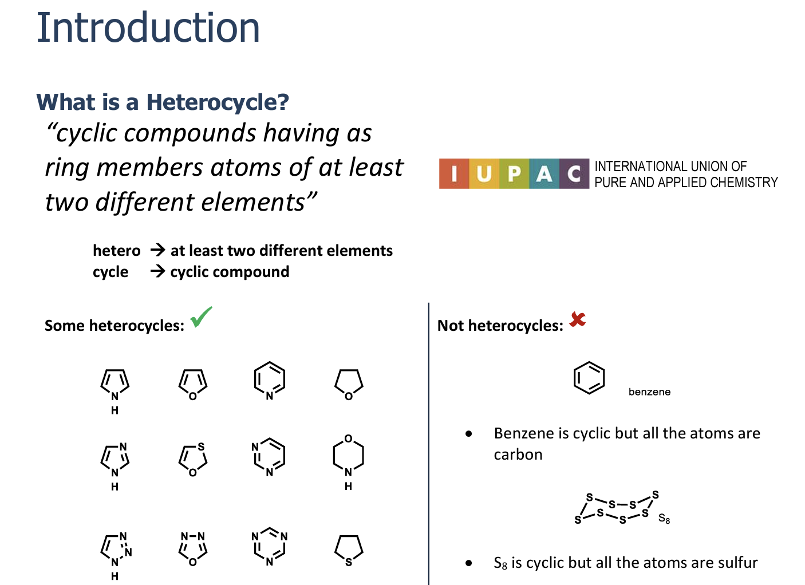
boyer-research.com/teaching
Notes:
Before we begin, let's remember what heterocycles are and why they are so important to us.
I'm sure you understand the word hetero, which means different, quite clearly. And in our case, it is the presence of other atoms in the cycle, except carbon.
Sulfur (салфа)

Slide 4
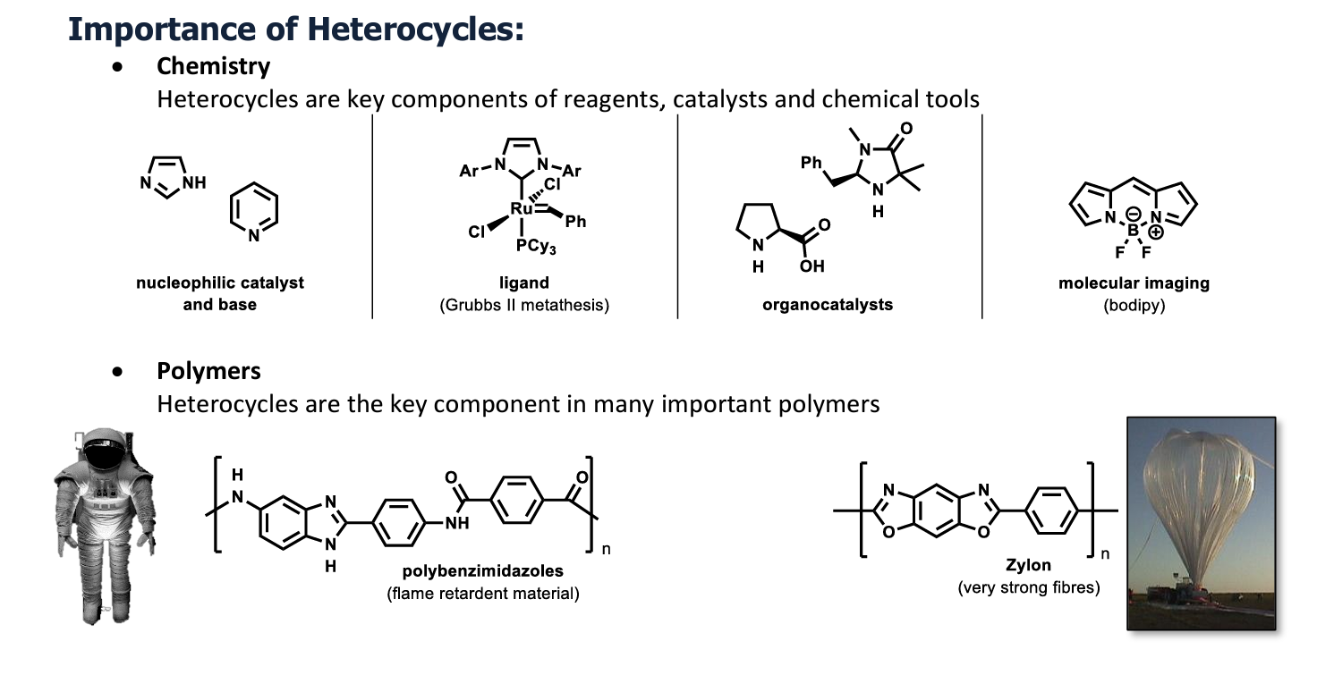
boyer-research.com/teaching
Notes:
zylon – зайлен
flame retardant material – флейм ретартед матіріал

Slide 5
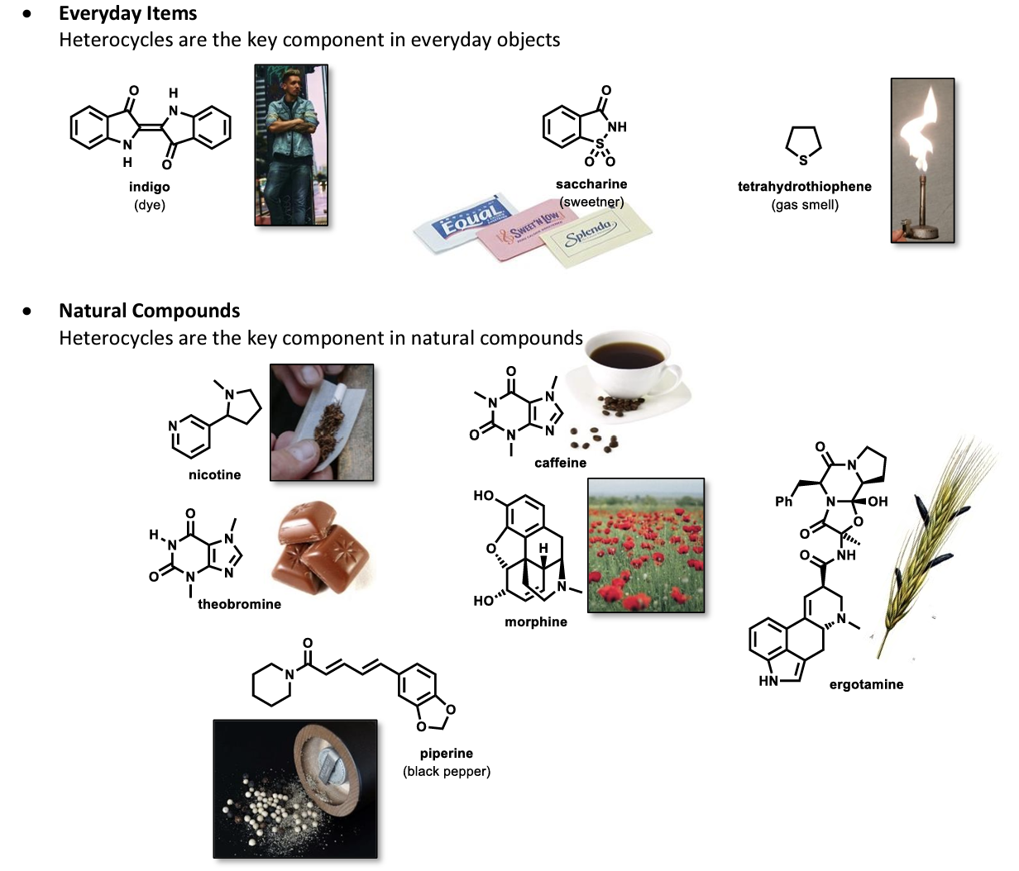
boyer-research.com/teaching
Notes:
Tetrahydrothiophene – тетрагайдросайофін
Нікатін, кафеїн
Theobromine – зейобромайн
morphine, ergotamine, piperine – моофін, ерготамін, пайперін

Slide 6
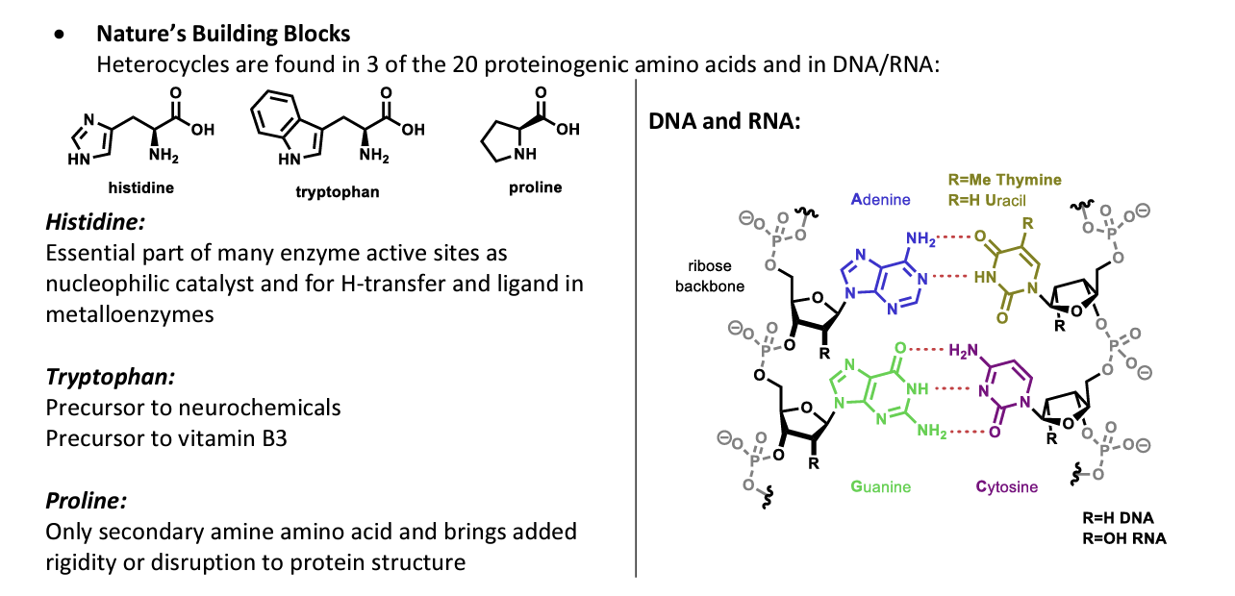
boyer-research.com/teaching

Slide 7
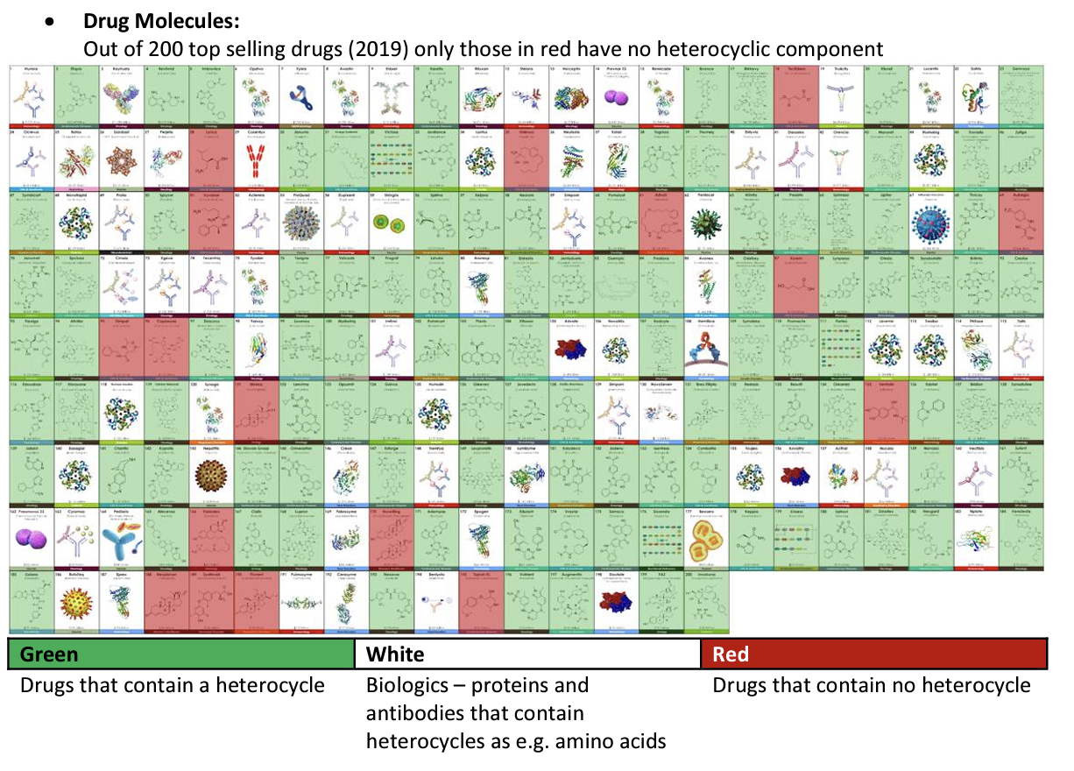
boyer-research.com/teaching
Notes:
Give your attention to this moment.

Slide 8
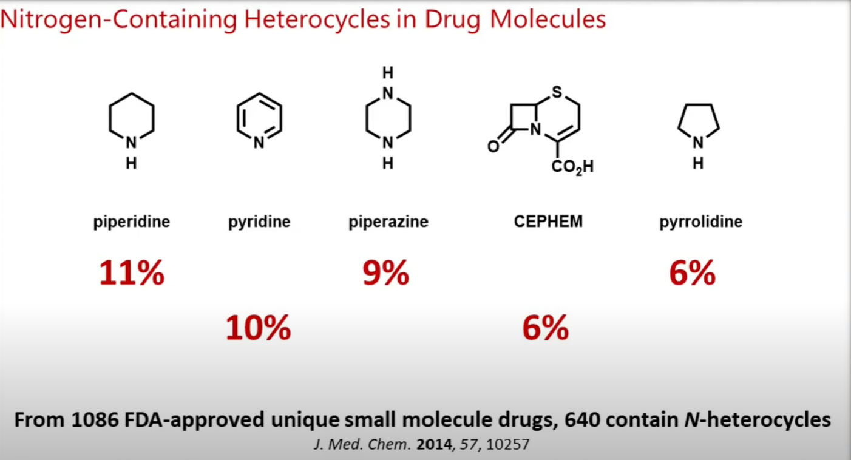
boyer-research.com/teaching
Notes:
Піпередин, пірідін, піперазін, пайролідін

Slide 9
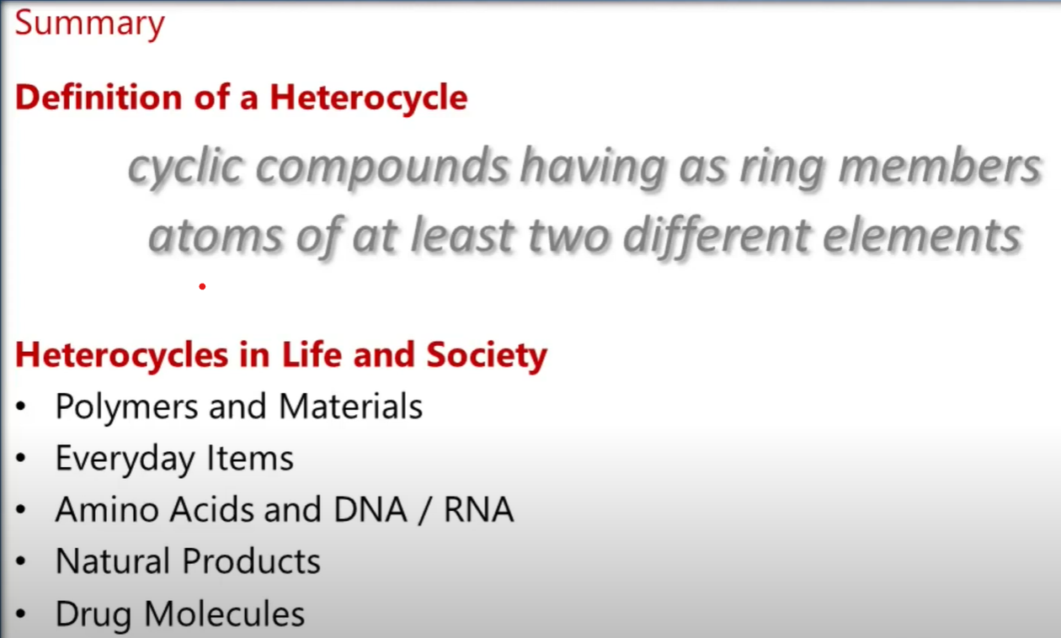

Slide 10
Nomenclature
IUPAC Rules
Three rule systems for naming heterocycles
I. Retained Names (Trivial names, Common Names)
Older heterocycles keep their traditional names
II. Hantzsch-Widman Nomenclature
Logical system of nomenclature. It is a type of systematic chemical nomenclature used for naming heterocyclic parent hydrides having no more than ten ring atoms.
III. Carbon-Framework Substitution Nomenclature (Replacement Nomenclature)
Complex heterocycles. It is used for the heterocycles containing unusual heteroatom(s), spiro-, and bridged heterocyclic systems, other heterocycles greater than 10-membered.
Notes:
So, now we focus directly on our topic.
We officially use three systems of rules for naming cycles.

Slide 11
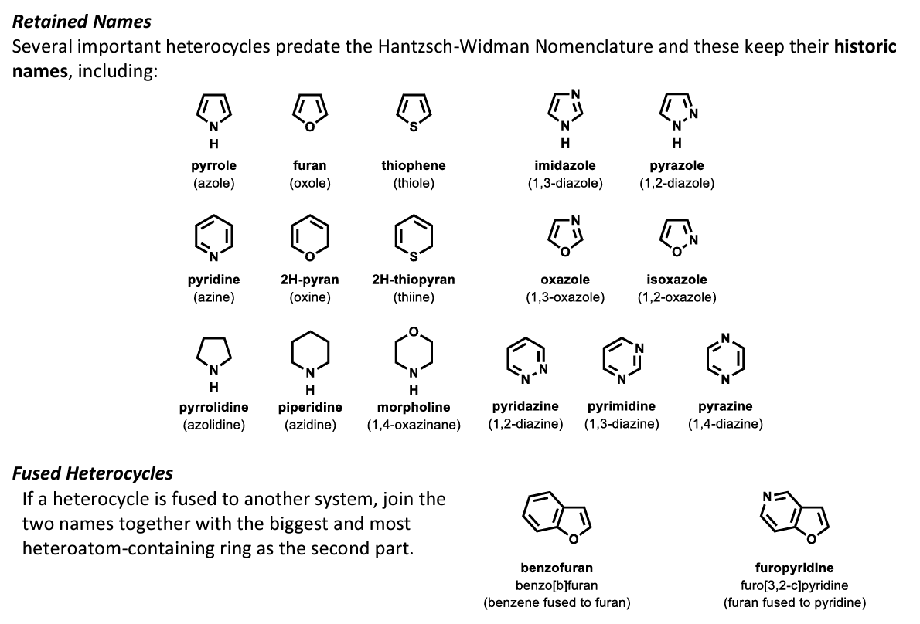
Retained Names
Many heterocycles, especially amines, were identified early on, and received trivial names which are still preferred.
Several important heterocycles predate the Hantzch-Wildman nomenclature and keep their historic names, including:
The trivial name is in bold, and a systematic name based on the Hantzsch-Widman system is given beneath it is not bold.
Notes:
Пайролей (азол), ф,ююрен (оксолей), сайосін (сайолей), імеедазол (ван, сри, дайазол
Піредин (езіін), ту ейч пайрон (оксіін)? Ту ейч сіопайрен (ciiн)
Пайролідін (езооліідін), піперідін (азіідін)? Моофолін (оксазенейн) пірідазін (дайазін) ? Пірімідін, піразін

Slide 12
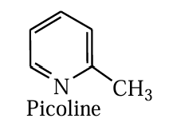
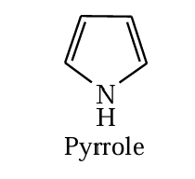
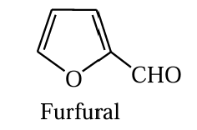
Retained Names
Many heterocycles, especially amines, were identified early on, and received trivial names which are still preferred.
Names of the heterocyclic organic compounds were given based on their occurrence, their first preparation and some characteristic properties.
For example picoline; picoline is derived from coal-tar. This is based on Lattin word pictus means tarry.
Pyrrole; which is basic in nature; the name of pyrrole was originated from the Greek word for fiery red because of characteristic colour which the compound gives with pine splint dipped in hydrochloric acid.
Similarly, the name furfural is given based on it’s source. Furfural means barn oil. Furfural was isolated from the distillation of barn.

Slide 13
Retained Names
At present, just over 60 trivial names recognized by the IUPAC system of nomenclature. These recognized names are used as a basis for constructing the names of other compounds, systematic names for polycyclic compounds and/or their derivatives.
The next two slides (№ 14, 15) contain an exhaustive list of these structures and their trivial names

Slide 14
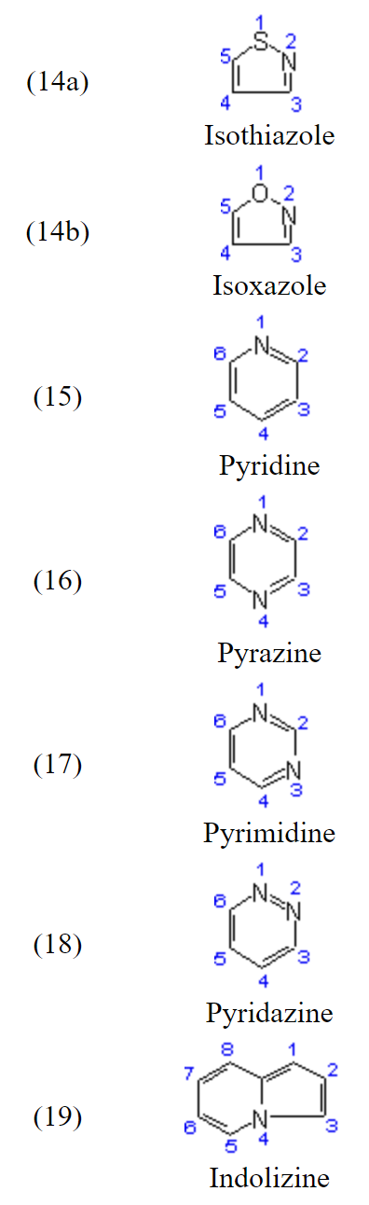
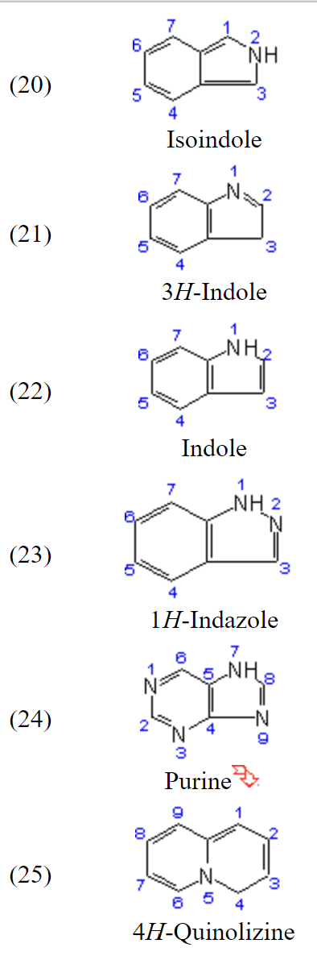
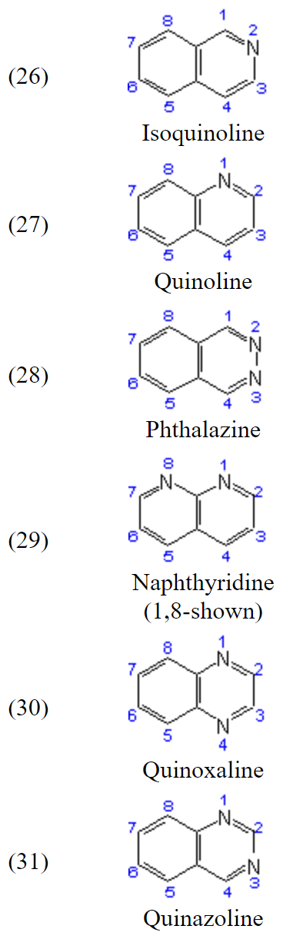
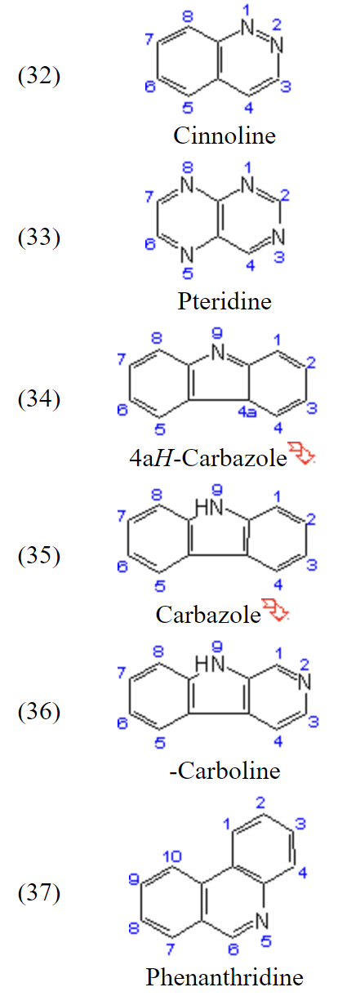
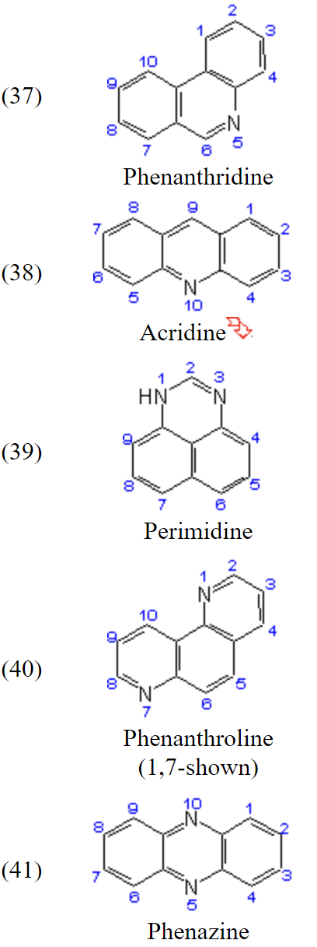
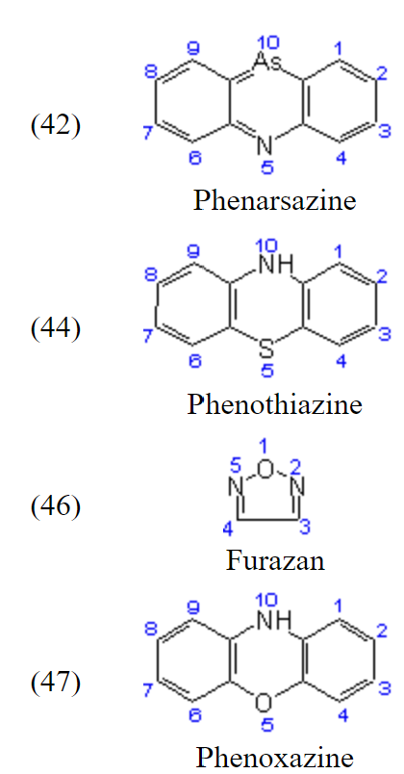
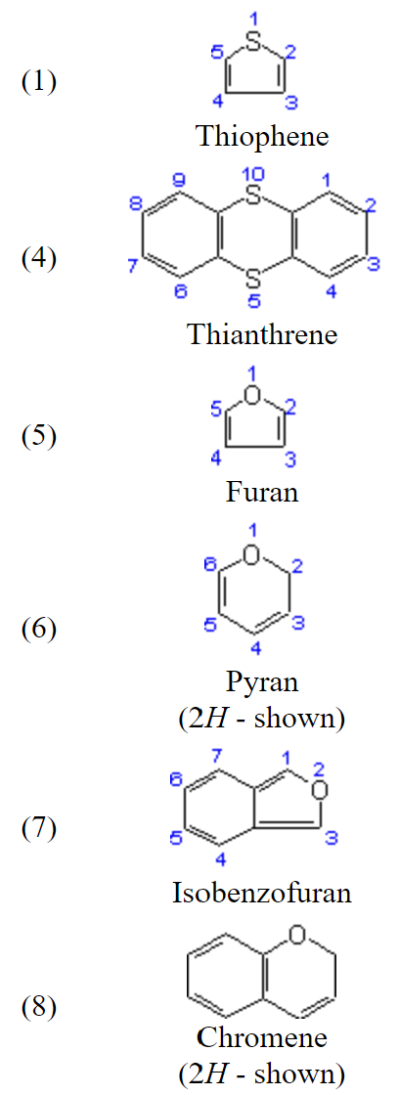
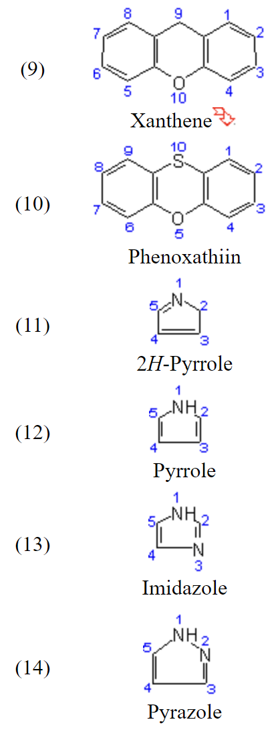
The following trivial and semi-trivial names constitute a partial list of names,
which are retained for forming fusion names.
Notes:
On this slide and next, I have made an exhaustive list of trivial names accepted by the IUPAC.

Slide 15
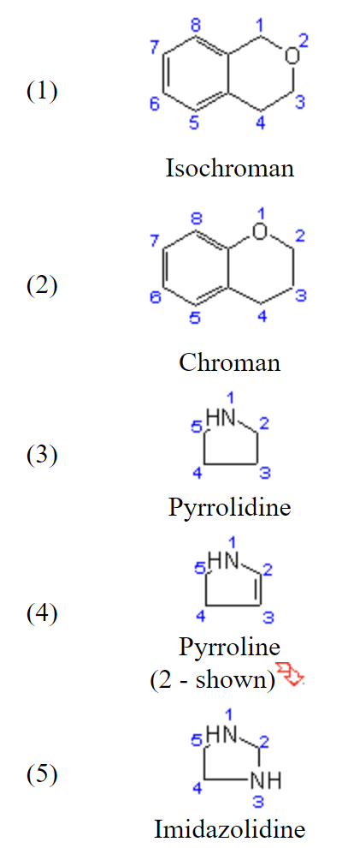
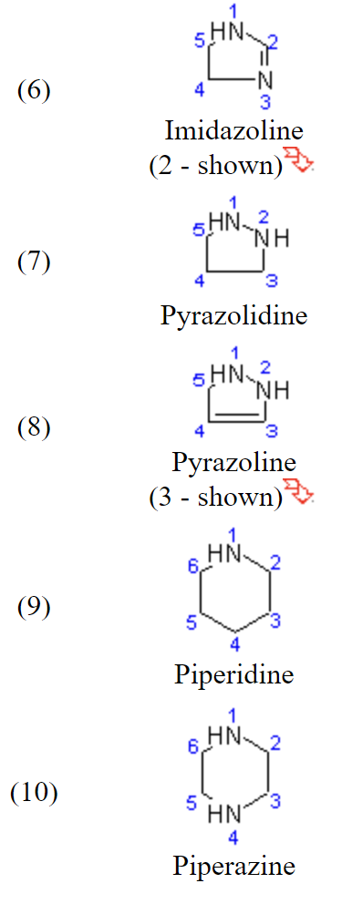
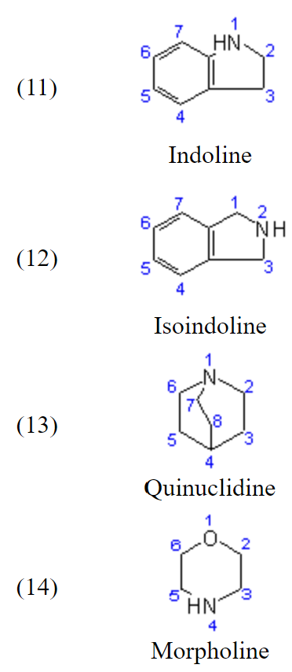
The following trivial and semi-trivial names are retained but are not recommended for use in fusion names.

Slide 16
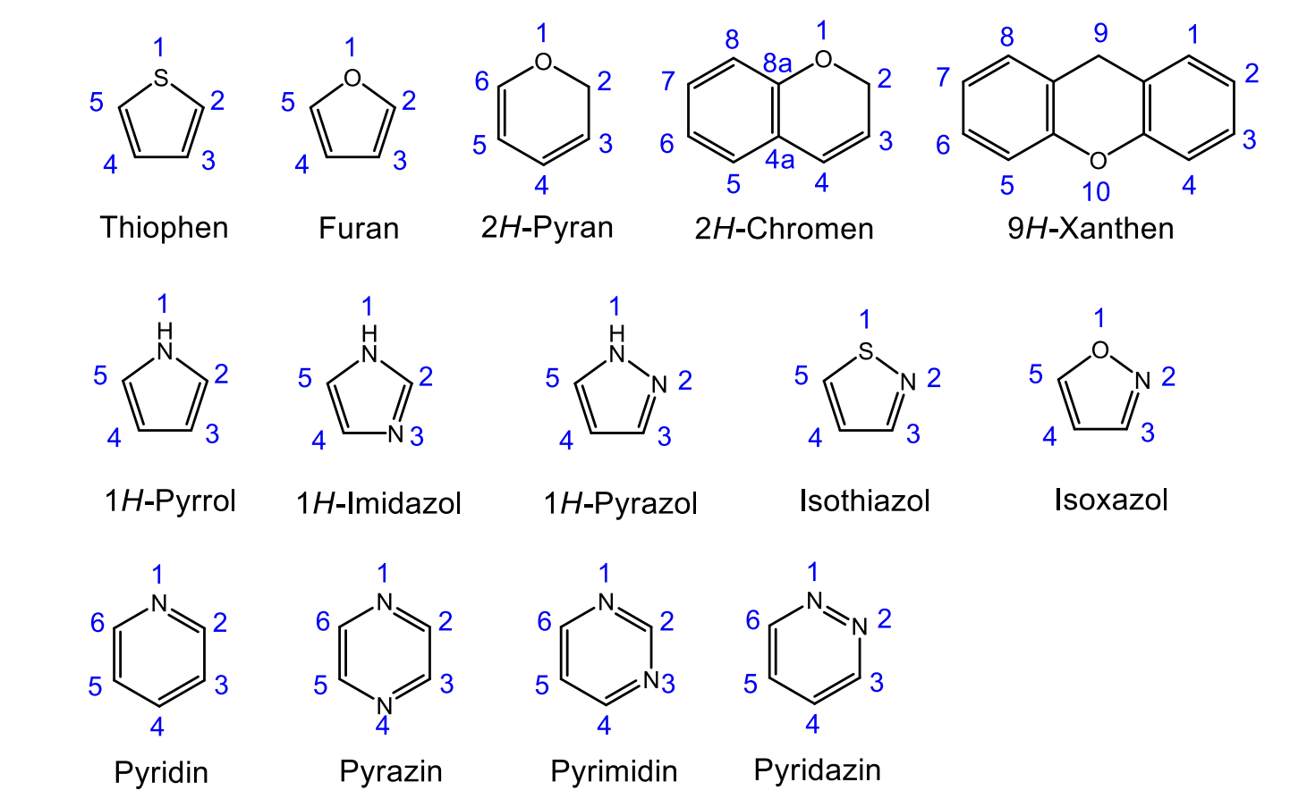
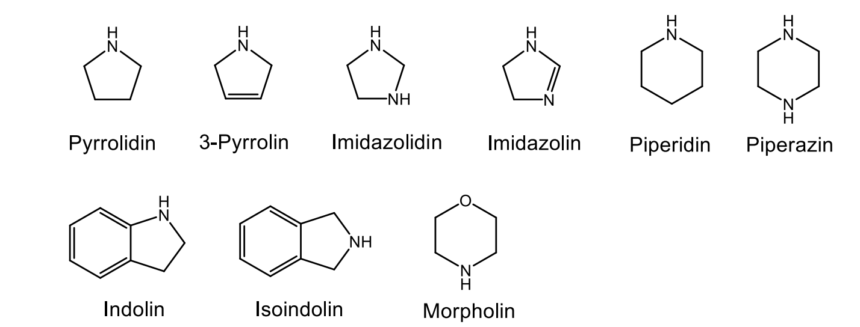
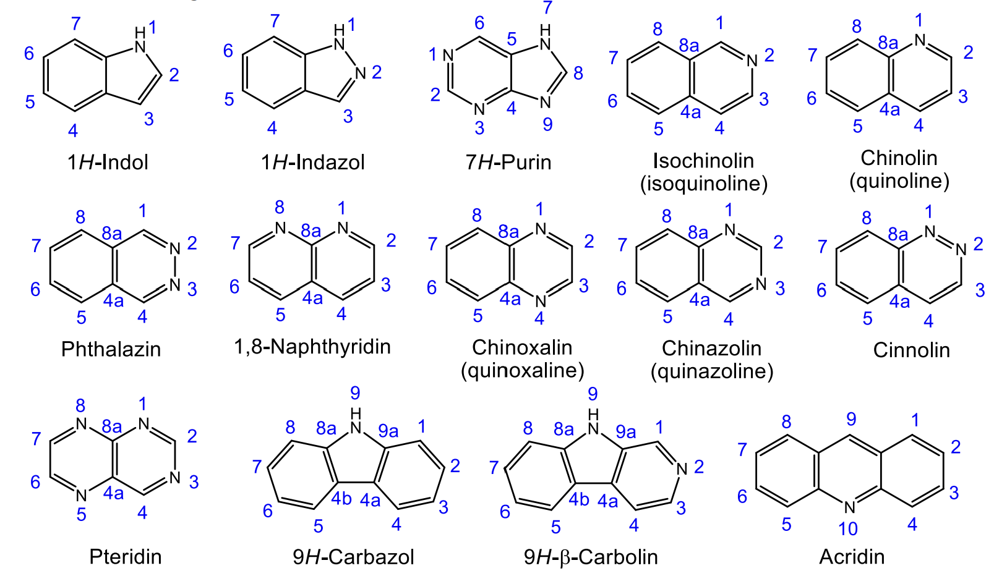

Task 1.
These compounds and their trivial names were presented in Prof. Müller's lecture. Please go through the code and try to match the names and structures. 5 minutes
A B C D E
https://forms.gle/SoVJ7uYDt7budwt26
Notes:
Now I suggest you check how carefully you listened to Professor Müller's lecture. Please go to the kr-code and try to pass a short test. We can immediately see the course of its results.

Slide 17

Trivial names can also be found in CAS REGISTRY
A CAS Registry Number (also referred to as CAS RN or informally CAS Number) is a unique identification number assigned by the Chemical Abstracts Service (CAS), US, to every chemical substance described in the open scientific literature.
It is a chemical database that includes organic and inorganic compounds, minerals, isotopes, alloys, mixtures, and nonstructurable materials (UVCBs, substances of unknown or variable composition, complex reaction products, or biological origin).
The registry maintained by CAS is an authoritative collection of disclosed chemical substance information.
204 million organic substances, alloys, coordination compounds, minerals, mixtures, polymers, and salts disclosed in publications since the early 1800s.

Slide 18
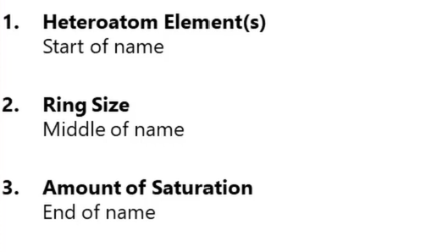
II. Hantzsch-Widman Nomenclature (system)
This is the most widely used nomenclature system for monocyclic heterocyclic compounds, especially for three to ten-membered ring systems. The systematic nomenclature gives important structural information.
There is a carefully formulated system for the nomenclature of heterocycles based on heteroatom(s), ring size, and degree of saturation.
Notes:
Today there will be more theory, I understand it's boring. I promise more real examples in the next seminar. Why do you need it?

Slide 19
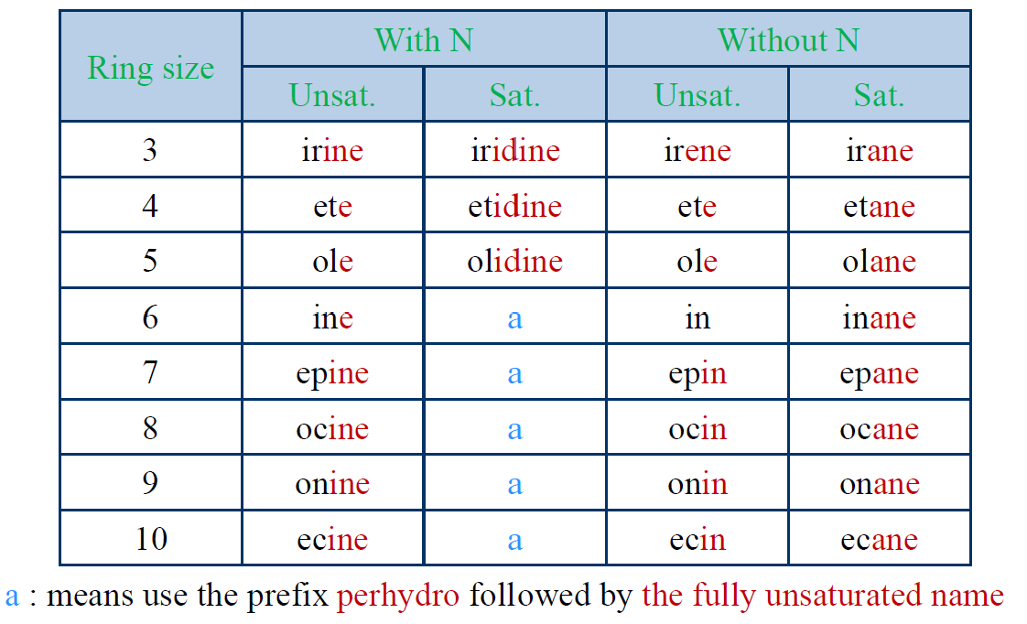
Hantzsch-Widman rules for fully saturated and fully unsaturated heterocycles
I. Type of the heteroatom
The type of heteroatom is indicated by a prefix as shown below for common heteroatoms:
II. Ring size (n)
The ring size is indicated by a suffix according to Table below. Some of the syllables are derived from Latin numerals, namely ir from tri, et from tetra, ep from hepta, oc from octa, on from nona, ec from deca.
III. Amount of saturation
The endings indicate the size and degree of unsaturation of the ring.
Heteroatom | Prefix
O | oxa-
S | thia-
N | aza- (often imid-, pyr-, pyrid-)
P | phospha-
Si | sila-
Ring Size | Suffix | Ring Size | Suffix
3 | -ir- | 7 | -ep-
4 | -et- | 8 | -oc-
5 | -ol- | 9 | -on-
6 | -in- | 10 | -ec-
O>S>N>P>Si (priority in case of heterotaoms)
IUPAC name = locants + prefix + suffix
3-Hantzsch-Widmannomenclature (IUPAC
boyer-research.com/teaching

Slide 20
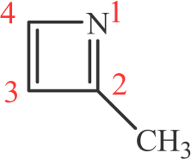

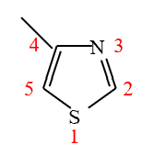
Hantzsch-Widman rules for fully saturated and fully unsaturated heterocycles
Identify the hetroatom present in the ring and choose the corresponding prefix (e.g. thia for sulfur, aza for nitrogen and oxa for oxygen).
The position of a single heteroatom control the numbering in a monocyclic compound.
The heteroatom is always assigned position 1 and if substituents present are then counted
around the ring in a manner so as to take the lowest possible numbers.
3) A multiplicative prefix (di, tri, ect.) and locants are used when two or more similar heteroatoms
contained in the ring (two nitrogen indicated by diaza) and the numbering preferably commenced
at a saturated rather than an unsaturated atom, as depicted in the following example: 1,3-diazole:
4) If more than one type of heteroatom is present in the ring, the name will include more than one prefix with locants to indicate the relative position of the heteroatoms.
Atom prefixes have a strict order of priority (preference) in which they are to be listed. For example,‘’Oxa’’(for oxygen) always comes before ‘’aza’’ (for nitrogen) in a name (see slide 17). When combining the prefixes (e.g. oxa and aza), two vowels may end together; therefore, the vowel at the end of the first part should be omitted (oxaza).
The numbering is started from the heteroatom of the highest priority in such a way as to give the smallest possible numbers to the other heteroatoms in the ring (the substituents are irrelevant).
5) Choose the appropriate suffix from (slade 19) depending on the ring size.
6) The endings indicate the size and degree of unsaturation of the ring.
7) Combine the prefix (s) and suffix together and drop the first vowel if two vowels came together.
For example:
4-Methyl-1,3-Thiazaole

Slide 21
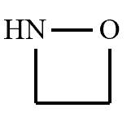
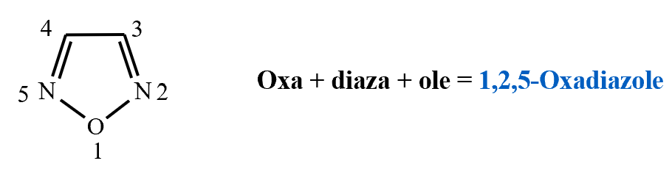
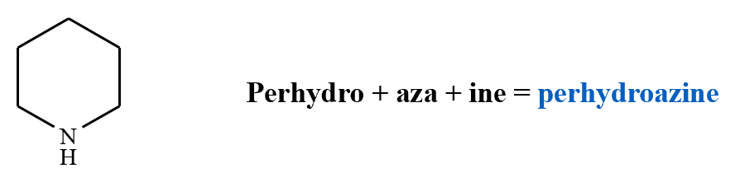
Hantzsch-Widman rules for fully saturated and fully unsaturated heterocycles
Examples:
H N
This ring contains (N): Prefix is aza
The ring is 3-membered and fully saturated: suffix is iridine
By combining the prefix and suffix, two vowels ended up together (azairidine), therefore the vowel on the end of the first part should be dropped. This gives the correct name: Aziridine
1)
Aziridine
This ring contains (O and N) (O has higher priority than (N) and by starting numbering the ring at (O): Prefix is 1,2-Oxaaza, but the first vowel must be omitted to give: 1,2-Oxaza
The ring is 4-membered and fully saturated: suffix is etidine
By combining the prefix and suffix, two vowels ended up together (1,2-oaxazaetidine), therefore the vowel on the end of the first part should be dropped. This gives the correct name: 1,2-oxazetidine
2)
1,2-oxazetidine
3)
4)

Slide 22
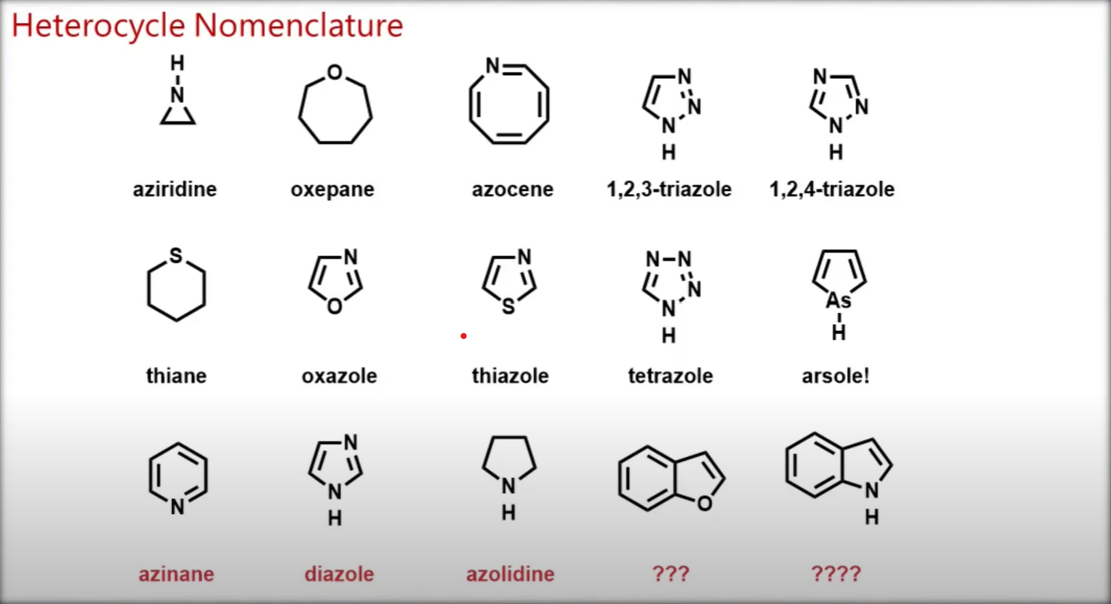

Slide 23
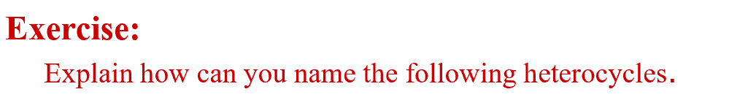
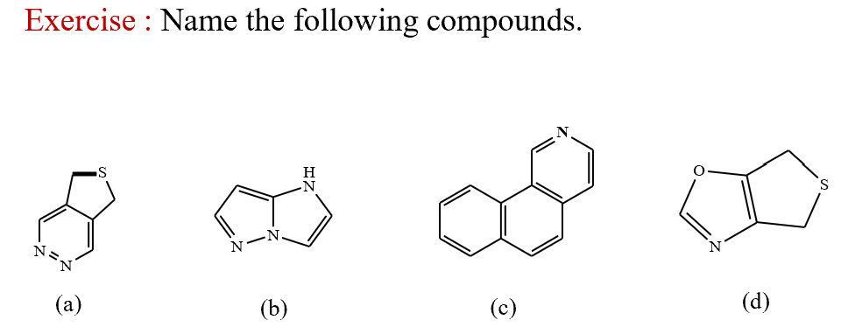

Task 2.
A B C D E
https://forms.gle/f6RUCcnU9nCfjUfj7

Slide 24
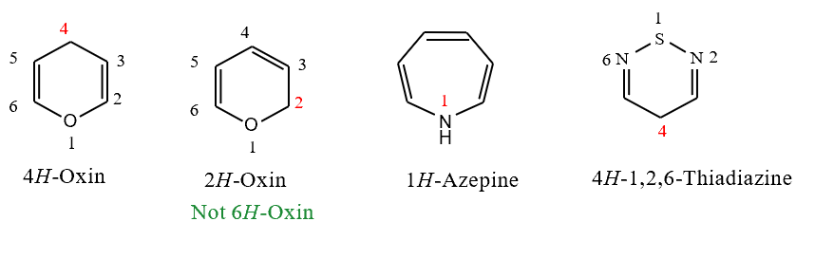
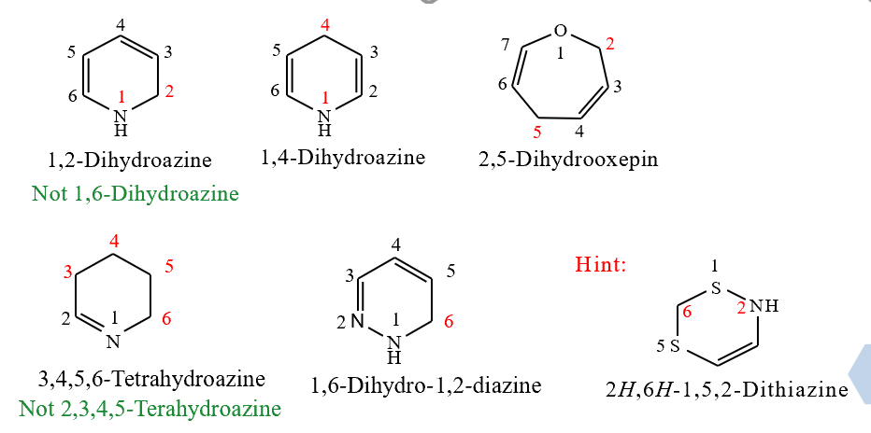
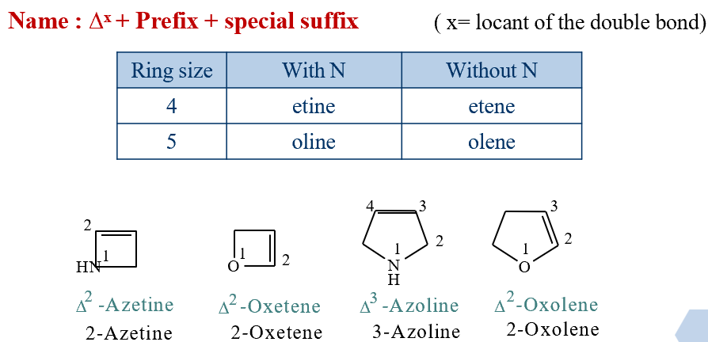
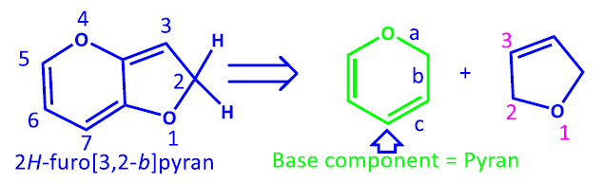
Hantzsch-Widman rules for partially unsaturated heterocycles
Partial unsaturation in heterocyclic compounds can be indicated by one of the following methods:
The position of nitrogen or carbon atoms which bear extra hydrogen atoms must be indicated by numbers and italic capital H (e.g. 1H, 2H, etc.) followed by the name of maximally unsaturated ring.
The words dihydro, or trihydro, or tetrahydro are used if two or three or four atoms are saturated. These words are preceded by numbers indicate the position of saturated atoms as low as possible and followed by the corresponding fully unsaturated Hantzsch-Widman name.
Alternatively, the partially unsaturated 4 and 5 rings (i.e. rings contain one double bond) are given special Hantzsch-Widman suffixes as in table 3 and the double bond is specified as ∆¹, ∆², ∆³, etc.. Which indicates 1 and 2 ; 2 and 3; 3 and 4 atoms respectively have a double bond.
Note that the position of unsaturation takes precedence in adopting the lowest possible location number (locant) starting at the heteroatom.
Notes:
Among the three regio-isomers of azole (common name: pyrrole), which is the most stable? Refer to the concept of aromaticity to rationalize the stability among the regiomers of pyrrole.

Slide 25










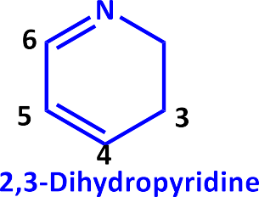
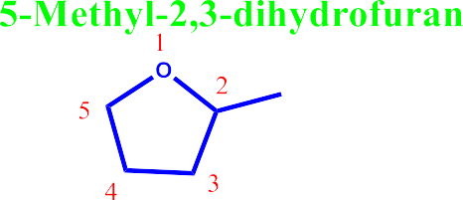






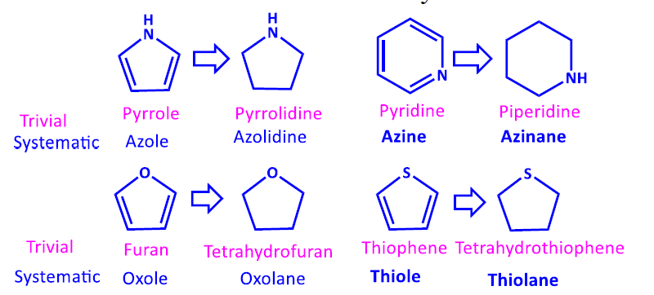
Examples

Slide 26
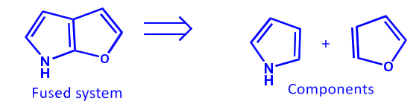
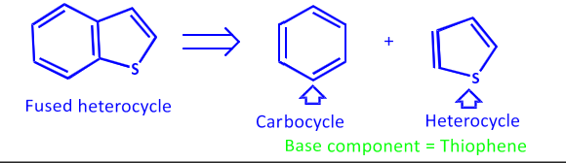
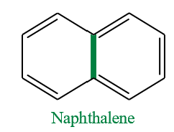
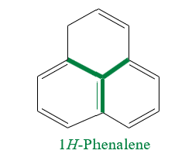
Nomenclature of Fused Systems
Fused heterocycles are systems constructed
by combining two or more cyclic systems.
Definitions:
Fusion: This term is used to describe the process of joining two separate rings with the maximum number of non-cumulative double bonds via two atoms and one common bond.
Ortho-fused rings: are those rings that have only two common atoms and one bond, example; Naphthalene
Ortho-and peri-fused rings: are those found in a polycyclic compound with a ring that is ortho- fused to different sides of two other rings that are themselves ortho-fused together (i.e. there are three common atoms between the first ring and the other two), example; 1H-phenalene is considered as being composed of three benzene rings, each is ortho-peri-fused to the other two.
Polycyclic compounds incorporating one heterocyclic ring or fused heterocylic system fused to benzene are known benzoheterocycles.
Also bicyclic compounds with two fused heterocyclic rings are well known.
Both types can be named according to certain rules.

Slide 27
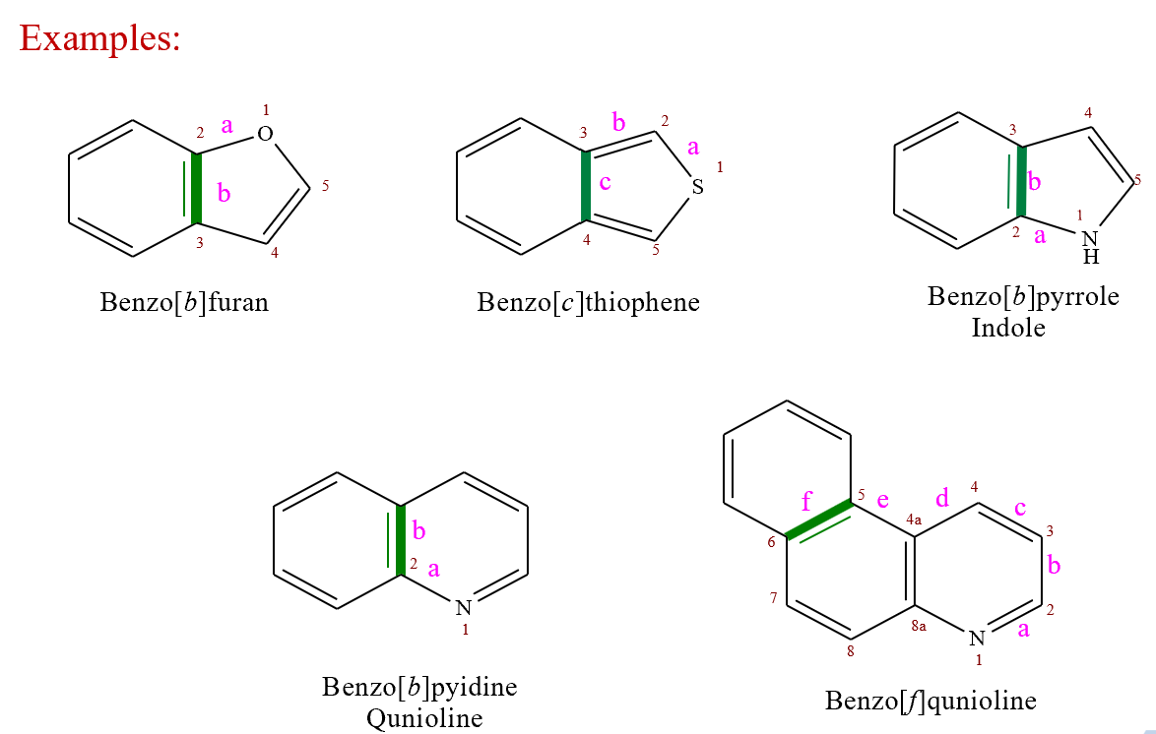

Nomenclature of Fused Systems
A. Nomenclature of benzofused compounds:
Unless listed as a trivially named heterobicycle (see slide 14, 15), a benzene ring fused to a heteromonocycle of five or more members or a heterobicylcle is named by prefixing the word benzo to a letter indicating the position of fusion in square brackets by the name of heterocyclic ring (common or IUPAC or modified replacement name).
Name = Benzo [letter] name of heterocyclic ring
For designating the position of fusion, the peripheral bonds of the heterocyclic ring are consecutively assigned alphabetical letters staring with the 1,2-bond as a side and the labeling is continued around the ring to give the common bond the lowest order.
If two benzene rings are ortho-fused to a six membered 1,4-dihetero monocyclic ring containing different atoms, then it is named by adding the prefix ‘pheno-’ to the H-W name of heterocycle.

Slide 28



Nomenclature of Fused Systems
There is an exception to the two ring systems in which a benzene ring is fused to a hetero ring (which doesn't have a known common name) may be named by prefixing numbers indicating the positions of the hetero atoms to benzo followed by the name of the heterocyclic component.
Numbering is assigned according to priority order of the hetero atoms i.e.
O < S < N
B. Nomenclature of fused heterocylic compounds:
Naming a fused heterocyclic systems composed of two monoheterocyclic units or benzoheterocycles (e.g. chromene) fused with another hetrocycle ring is based upon considering one system as the parent (base) and the second is considered as substituent.
Name : name of minor ring [number, number-letter] name of major ring
The name of the minor ring is derived by writing a contracted prefix for the substituent ring present. In an attached component prefix the terminal ‘e’ is changed to ‘o’ with exception of:
The base component should always be a heterocyclic system.
The components are given their recognized trivial names (if possible) else, systematic name is used.

Slide 29

Nomenclature of Fused Systems
The numbers indicate which atoms in the minor ring are common to the major ring (fusion sites in minor ring).
The order of the numbers indicates which atom of the minor ring is encountered closest to atom 1 in the major numbering system (i.e. these numbers may be written in ascending or descending order e.g.2,3 or 3,2 )
The letter defines the position of attachment of the minor ring to the major ring (fusion sites in base component).
Finally a suffix indicate the name of the base ring is written.
The numbering system for the whole fused system is not the same as the numbers in the square brackets (i.e. there are three numbering systems; one for minor ring, one for major ring and the third is for the system as a whole).
Priority order of component ring systems: Selection of a parent component or attached component is based on the following rules which are applied in order:
Rule 1: A heterocyclic ring containing the heteroatom occuring earlist in the order N, F, Cl, Br, I, O, S, Se,.. (i.e. ring containing N preferred to the rings does not contain N or containing O, or S)

Slide 30


Slide 31


Rule 2: A heterocyclic component containing the largest possible individual ring
Rule 3: A heterocyclic component containing the greater number of hetroatoms of any kind
N.B. The whole molecule is numbered starting from pyridine ring to give the three heteratoms the lowest locants (1,6,7), however, stating from oxazine ring will give them locants (2,3,5) or (2,3,8).

Slide 32


Rule 4: A heterocyclic component containing the greater variety of hetroatoms
Rule 5: A heterocyclic component containing the greater number of heteroatoms most preferred when considered in order F, Cl, Br, I, O, S, Se, Te, N, P, As, Sb, Bi, Si, Ge, Sn Pb, B, Hg
N.B. The whole molecule is numbered starting from pyrazole ring to give the four heteratoms the lowest locants (1,2,4,6). While starting from oxazole ring give them locants (1,3,4,5) or (1,3,5,6).

Slide 33


Rule 6: A heterocyclic component with the lower locants for heteroatoms
Rule 7: If a position of fusion is occupied by a heteroatom the name of the component rings to be used are so chosen as both to contain the heteroatom.

Slide 34




Order of preference between alternative numbering system of the whole molecule
Numbering the whole fused system should start from the first atom after fusion in any direction to fulfill the following rules in order:
a) Give low numbers for the heteroatoms as a set b) Give low numbers for heteroatoms of higher priority i.e. O, S, N
c) Give low numbers to fusion carbon atoms
d) Give low numbers to indicated hydrogen atom

Slide 35



Order of preference between alternative numbering system of the whole molecule
Fused heterocyclic system is numbered independently of combining components. The numbering is started from the atom adjacent to the bridgehead position with the lowest possible locant(s) to the heteroatom(s). If there is choice, priority is given according to the table.
Carbon atom common to two rings is given the lowest possible position, both not numbered. However, the common heteroatom is numbered.
The position of a saturated atom is indicated by an italic hydrogen and is given the lowest possible number locant.

Slide 36

Summary of Nomenclatures Rules

Slide 37

Summary of Nomenclatures Rules
The fused heterocyclic system is dissected into its components: one is the base component, and the other(s) is the attached component(s).
The components are given their recognized trivial names (if possible); else, a systematic name is used.
The base component should always be a heterocyclic system. If there is a choice, it is determined by order of preference.
The attached component is added as a prefix to the name of the base component. The terminal ‘e’ is replaced by ‘o’.
The bonds of the base component are alphabetized with consecutive italic letters starting with ‘a’ for 1,2-bond…..
The atoms common to both rings (side of fusion) are indicated by appropriate letters, and numbers are enclosed in a square bracket and placed immediately after the prefix of the attached component. The numbers (positions of attachment) of the second component are placed in the sequence in which they are attached to the base component.
Atoms and other components are numbered in the usual way 1,2,3….according to the principle of the lowest possible numbering.
If a heteroatom occupies a fusion position, it is assumed that the ring systems of both components have this heteroatom.

Slide 38











Summary of Nomenclatures Rules
Scheme for deriving the base component of a fused ring system
1. Is there only one ring that contains nitrogen?
Yes: choose this as a base component
2. If nitrogen is absent, then ring with another heteroatom(s) is selected as a base component (order of preference as in the table). The component with the greatest number of rings is selected and named with recognized trivial name if possible.
3. Are the two rings have identical heteroatoms but their size is different?
Yes: choose the larger one
4. Are the two rings of the same size but have different heteroatoms?
Yes: choose the ring containing a heteroatom of the highest priority i.e. O >S
5. Are the rings of the same size but contain different numbers of heteroatoms?
Yes: choose the ring with the greater number
6. Are the two rings of the same size and the same number of different heteroatoms?
Yes: choose the ring with the greatest variety of heteroatoms
7. Are the two rings have the same size and the same number and type of heteroatoms?
Yes: choose the ring with the lower numbers for heteroatoms
More examples here https://www.acdlabs.com/iupac/nomenclature/79/r79_960.htm

Slide 39

Task 3.
https://forms.gle/sJ29iYo46ZV9ZthJ7

Slide 40
Thank you for your attention!

Slide 41












Heterocycles from lecture #1

Slide 42
Additional materials

Slide 43

boyer-research.com/teaching

Slide 44

boyer-research.com/teaching

Slide 45

boyer-research.com/teaching

Slide 46

boyer-research.com/teaching

Slide 47

(THF)

Slide 48


Slide 49


Slide 50
Nomenclature of heterocycles II. seminar
Assoc. prof., Dr. Maryna M. Kornet
Head, Laboratory of Biotechnology of Physiologically Active Substances; Associate Professor, Department of Chemistry
Zaporizhzhia National University (Zaporizhzhia, Ukraine)
kornetmaryna@ukr.net
26.04.2023
Notes:
AToday we have an enough important topic for the seminar - the nomenclature of organic compounds.

Slide 51
Task 3.
4,6-dihydrothieno[3,4-d]oxazole
1H-imidazo[1,2-b]pyrazole
5,7-dihydrothieno[3,4-d]pyridazine
benzo[h]isoquinoline
https://forms.gle/sJ29iYo46ZV9ZthJ7
Notes:
So, dear students, we will start by analyzing your answers to the last exercise from the last seminar. The most accurate answers are marked in green.

Slide 52
1) Is there only one ring that contains nitrogen?
Yes: choose this as a base component
(pyridazine)
2) 2) The name of the minor ring is derived by writing a contracted prefix for the substituent ring present. In an attached component prefix, the terminal ‘e’ is changed to ‘o’ except for:
3) The position of nitrogen or carbon atoms that bear extra hydrogen atoms must be indicated by numbers and italic capital H (e.g., 1H, 2H, etc.) followed by the name of a maximally unsaturated ring.
The words dihydro, trihydro, or tetrahydro are used if two, three, or four atoms are saturated. Numbers preceding these words indicate the position of saturated atoms as low as possible and are followed by the corresponding fully unsaturated Hantzsch-Widman name.
Task 3, Compound a

Slide 53
1) Are the two rings have the same size and the same number and type of heteroatoms?
Yes: choose the ring with the lower numbers for heteroatoms (pyrazole)
2) The name of the minor ring is derived by writing a contracted prefix for the substituent ring present. In an attached component prefix, the terminal ‘e’ is changed to ‘o’ exception for:
Imidazole = Imidazo
3) About 1H. The numbering system for the whole fused system is not the same as the numbers in the square brackets (i.e., there are three numbering systems; one for a minor ring, one for a major ring, and the third for the system as a whole).
Numbering the whole fused system should start from the first atom after fusion in any direction to fulfill the order of the following rule: Give low numbers to an indicated hydrogen atom.
Task 3, Compound b
1H-imidazo[2,3-b]pyrazole
Notes:
That is an interesting point. When we first look at imidazole, many of us (myself included) want to write the 2,3 bond as the attachment site. But in fact, 1.2 is correct here. You can check it using various programs. The compound 1H-imidazo[2,3-b]pyrazole does not exist.

Slide 54

Several important heterocycles predate the Hantzch-Wildman nomenclature and keep their historic names (isoquinoline)
Important!
If possible, choose from the list of IUPAC-recognized trivial names as large as possible as the main component.
2. The letter defines the position of attachment of the minor ring to the major ring (fusion sites in the base component). The 1,2 bond in isoquinoline corresponds to the letter "a".
Task 3, Compound c
Pyrido[2,3-b]naphthalene
Naphto[1,2-c]pyridine
Notes:
You could find an example of this compound in Professor Müller's lecture.

Slide 55
1) Is there only one ring that contains nitrogen?
Yes: choose this as base component
(oxazole)
2) The words dihydro, trihydro, or tetrahydro are used if two, three, or four atoms are saturated.
Tetrahydrothiophene = Thieno
The molecule consists of a five-membered saturated ring with four methylene groups and a sulfur atom. It is the saturated analog of thiophene.
3) The numbering system for the whole fused system is not the same as the numbers in the square brackets (i.e., there are three numbering systems; one for a minor ring, one for a major ring, and the third for the system as a whole).
Numbering the whole fused system should start from the first atom after fusion in any direction to fulfill the order of the following rule :
a) Give low numbers for the heteroatoms as a set
Task 3, Compound d
Notes:
Most of you have marked this part correctly. But you had problems in the beginning.

Slide 56

Task 4.
https://forms.gle/4S127ZhUmUYnRem5A

Slide 57



Сompound (а)
Сompound (c)
Сompound (b)
Notes:
Please change places.

Slide 58
III. Carbon-Framework Substitution Nomenclature (Replacement Nomenclature)
In replacement nomenclature, the heterocycle’s name is composed of the corresponding carbocycle’s name and an elemental prefix for the heteroatom introduced (if more than one heteroatom is present, they should be listed according to the priority order shown in table (A).
This system is based on the fact that the heterocyclic compounds are derivatives of carbocyclic compounds. Therefore, the nomenclature rules are similar to those applied to the carbocyclic compounds.
It is used for the heterocycles containing unusual heteroatom(s), spiro-, and bridged heterocyclic systems, and other heterocycles greater than 10 membered.
According to this nomenclature, tetrahydrofuran, for instance, is called oxacyclopentane.
Table-A
Atom | Prefix
O | oxa
Se | selena
S | thia
N | aza
P | phospha
Priority decreases
Heterocyclic Chemistry, R. R. Gupta, M. Kumar, V. Gupta, 1998

Slide 59

Heterocyclic Chemistry, R. R. Gupta, M. Kumar, V. Gupta, 1998

Slide 60







III. Carbon-Framework Substitution Nomenclature (Replacement Nomenclature)
N
1,4-Diazabenzene
Benzene
N
1,3-Cyclopentadiene
Oxacyclopenta-2,4-diene
O
1,3-Cyclopentadiene
N
1-Oxa-3-azacyclopenta-2,4-diene
O
Cyclopropane
Oxacyclopropane
O
Cyclopropene
N
Oxazacyclopropene
O
1,3-Cyclopentadiene
N
S
O
1-Thia-2-azacyclopenta-2,4-diene
Cyclohexane
1-Oxa-4-azacyclohexane
N H
5
4a
4
6
3
naphthalene
2
2-Azanaphthalene
7
8a
N
8
1

Slide 61


III. Carbon-Framework Substitution Nomenclature (Replacement Nomenclature)
cyclohexane
Thiacyclohexane
S
8
8a
1
1
7
2
naphthalene
3
2
4H-4a-azanaphthalene
6
4a
N
4a
3
5
4
4
8
8a
1
7
2
naphthalene
3
S
6
1,4-dithianaphthalene
5
4a
4
S
2 ₁
O
N
7 8
cyclododecadiene
1,7-Dioxa-2,8-diazacyclododeca-2,8-diene

Slide 62
III. Carbon-Framework Substitution Nomenclature (Replacement Nomenclature)
Monocyclic Heterocycles
Fused Heterocycles
Spiro Heterocycles
Bridged Heterocycles
Heterocyclic ring assemblies

Slide 63



Monocyclic Heterocycles:
The ring obtained from the heterocyclic compound by replacing heteroatom(s) by CH2, CH, or C according to the valence of heteroatom(s) is named by IUPAC rules.
The type of heteroatom is indicated by the prefix (according to the table 1). Since all the prefixes end with the letter ‘a’ the replacement nomenclature is also known as ‘a’ nomenclature. The position and prefix for each heteroatom are placed before the name of the corresponding carbocyclic system.
The replacement names derived from benzene are retained only if three double bonds are present, otherwise, the names with -ene, -diene, etc as necessary are used.
The sequence and numbering of the heteroatoms follow the rules as in systematic nomenclature. However, the preferential order is:
1st preference: heteroatom appearing highest in the table 1.
2nd: Other heteroatoms according to the table.
3rd: Multiple bonds.
4th: substituents, if there is a choice, alphabetical order is followed.

Slide 64






Task 5. Name the following compound by replacement nomenclature
(a) (b) (c)
(d) (e) (f) (g)
https://forms.gle/6u3BuT4ovconQCaPA
Notes:
There are hints here, because I added the numbering order for some compounds.

Slide 65









Fused Heterocycles:
The position(s) and prefix(es) for the heteroatom(s) are written in front of the name of the corresponding carbocyclic ring. The numbering of the corresponding carbocyclic ring is retained irrespective of the position(s) of the heteroatom(s). However, the lowest possible number of locants are assigned to the heteroatoms in the complete fused heterocyclic system. If there is a choice, Table A (slide 58) is followed.
The heteroatom at the ring junction is assigned an individual number in fusion nomenclature, whereas, in the replacement nomenclature system, the heteroatom at the ring junction is given the same locant as an adjacent non-conjunction carbon atom but with the suffix ‘a’ or ‘b’, etc.
The corresponding carbocyclic ring without a maximum number of non-cumulative double bonds is named without using a prefix for a hydrogen atom. The ring is named after its state of hydrogenation.
If the corresponding carbocyclic ring is without a maximum number of non-cumulative double binds, the heterocyclic system is considered to be with a maximum number of conjugated or isolated double bonds. The corresponding carbocyclic ring is named as it contains a maximum number of non-cumulative double bonds.
The additional hydrogen atom, if present, is indicated by an italic capital ‘H’ with its position and placed before the position(s) and the prefix(es) of the heteroatom(s)

Slide 66



Spiro Compounds
The structure is called a spirocyclic compound if the two rings share a single atom.
• In “spiro” fused molecules, the two rings are joined at the same carbon.
• A spirobicycloalkane is a molecule in which only one carbon atom is shared by the two rings in the molecule.
• The carbon atom shared by the two rings is called the spirocarbon.
• A chain of bonds originating and ending at the spirocarbon is called a bridge.
• The compound below is named spiro[4.5]decane to communicate the number of carbons in each bridge with the spirocarbon.
Notes:
This slide presents general information about spiro compounds. Just so you can remember "what it is".

Slide 67


Slide 68




Spiro Heterocycles:
The compounds in which two rings are fused at a common point are known as spiro compounds and the common atom which is quaternary in nature is designated as spiro atom. They are classified according to the number of spiro atoms; monospiro-, dispiro-, trispiro- ring systems.
1. Spiro heterocycles with one spiro atom consisting of one or both heterocyclic rings are named by prefixing spiro to the name of a normal alkane with the same number of carbon atoms. The number of atoms in each ring is indicated by Arabic numerals separated by a dot, enclosed in square brackets in ascending order, and placed between the prefix spiro and the hydrocarbon name. The heteroatoms are indicated by the prefixes and are prefixed with their positions to the name of spiro hydrocarbon.
2. The numbering starts from the ring atom of the smaller ring (if rings are of unequal size) attached to the spiro atom and proceeds first around the smaller ring and then around the larger ring through the spiro atom. The heteroatoms are assigned the lowest possible number of locants. If there is a choice between two different heteroatoms, the preferential numbering is decided according to the appearance of the heteroatoms in the table.
3. The heterocyclic ring is preferred over the carbocyclic ring of the same size. If both the rings are heterocyclic, the preference is given to the heterocyclic ring with the heteroatom appearing in the table.

Slide 69






Spiro Heterocycles:
4. If unsaturation is present in a ring, the pattern of numbering remains the same but the direction around the ring remains in such a way that the multiple bond is given a number as low as possible. However, the heteroatom is preferred over the multiple bonds.
5. When one or both the components of the spiro heterocycle are fused polycyclic system, the names of both the components are cited after the prefix ‘spiro’ in square brackets in alphabetical order and are separated by the numbers of spiro atom. The components in such a spiro heterocyclic system retain their numbering, but the second component is numbered by primed numbers.
Spiro[cyclopentane-1,3'-indole]-2,4-diene
6. If both the heterocyclic components are the same in the spiro heterocyclic system, ‘spirobi-’ is prefixed to the name of a heterocyclic component.
3,3’-Spirobi[indole]

Slide 70



Task 6. Name the following compound by replacement nomenclature
(a) (b) (c)
https://forms.gle/9SBDcFX3YNUBga9f6

Slide 71



Bridged Compounds: Bicyclic system
Bridged bicycles are named according to a unique system of their own
Notes:
First, stereochemistry. One important note about bridged bicyclic molecules is that the two carbons forming each bridge will always be “cis” to each other, never trans, relative to the other ring.* [exceptions? yes, but you probably won’t see ’em – check Note 2 if you’re curious]
Why? Like we said in the last post when discussing trans-decalin, for much the same reason that you can’t kiss yourself on the back – there just isn’t enough flexibility for this to happen without breaking something. Given the strict bond angle (109°) and length (1.50 Å) requirements of alkanes, five, six, and seven membered rings don’t have enough slack to tolerate anything other than cis ring junctions. A trans ring junction (much like a trans double bond in rings of these sizes) would simply lead to too much ring strain.
Note that in the diagram below, the “cis” ring junctions is implied by the fact that both hydrogens are on the same side (both dashes in this case). The “impossible” trans ring junction is shown in grayscale for comparison. The picture shows a model of this molecule highlighting the angle strain and Van Der Waals strain resulting from this arrangement.
https://www.masterorganicchemistry.com/2014/08/14/bridged-bicyclic-compounds-and-how-to-name-them/#notetwo

Slide 72


A Few More Examples Of Bicyclic Molecules

Slide 73

Bridged Heterocycles: Bicyclic system
Bridged heterocyclic systems are named according to the rules for bridged hydrocarbons. The heteroatoms with their locants are prefixed to the name of bridged hydrocarbon.
The bridged heterocyclic system consisting of two or more common atoms is given the name of acyclic hydrocarbon with the same total number of carbon atoms, which is preceded by the prefix ‘bicyclo-’ with the descending order of numbers separated by a dot in square bracket indicating heteroatoms with their locants are prefixed to the name of bridged hydrocarbon.
The numbering starts from one of the bridgehead atoms and proceeds through the longest possible route to the second bridgehead atom and then by the second longest route to the first bridgehead atom and finally by the shortest route from one bridgehead to the second bridgehead atom.
The heteroatom is given a number as low as possible.
When there is a choice, between heteroatom and multiple bond, the heteroatom is preferred.
If there is a comparison between heteroatoms, the preference of numbering is given according to the table and their prefixes with locants are arranged alphabetically.
Example:

Slide 74

The nomenclature of such a structure consists of the prefix bicyclo, followed in square brackets by the number of carbon atoms separating the bridgeheads by the three possible routes in descending numerical order.
This is followed by the alkane containing the same number of carbon as the whole bicyclic heterocyclic skeleton.
The following examples illustrate the use of this rule.

Slide 75


Slide 76

Task 7. Name the following compound by replacement nomenclature
(a) (b) (c)
https://forms.gle/A5ZQ9JtVcemAEzBf8

Slide 77

Bridged Heterocycles: Polycyclic System
1. Polycyclic bridged heterocycles are also named according to the rules adopted for bicyclic bridged heterocycles. However, the prefix tricyclo-, tetracyclo-, etc., depending on the number of rings is used.
2. The prefix (cyclo-) is followed by the numbers separated by full stops in square brackets in decreasing order indicating:
The number of atoms or two branches of the main ring containing a maximum number of atoms.
The number of atoms in the main bridge excluding bridgehead atoms and
The number of atoms in secondary bridges
3. The location of each secondary bridge (the position of bridgehead atoms involved in the secondary bridges) is indicated by superscripts to the numbers indicating its length and is separated by a comma.
4. The prefix (tricyclo-, etc.,) with numbers separated by a full stop in a square bracket is followed by the name of acyclic hydrocarbon if the carbon atoms are equivalent to the total number of atoms in the bridged heterocyclic system.
5. The prefixes for the heteroatoms and the substituents with their positions are indicated and placed as usual.
Example:

Slide 78



Heterocyclic Ring Assemblies
Two or more heterocyclic ring systems, single or fused, joined to each other by single or double bonds are called heterocyclic ring assemblies.
The following rules are adopted for naming heterocyclic ring assemblies:
1. The heterocyclic ring assembly of two identical heterocyclic systems is named by prefixing ‘bi’ before the name of the heterocyclic system or its corresponding radical.
2. The numbering of the heterocyclic ring assembly is similar to that of the heterocyclic system or its corresponding radical. One heterocyclic system is assigned with unprimed numbers and the other with primed numbers. The points of attachment are indicated and placed before the name.
3. If there is a choice, the heterocyclic ring with a lower-numbered point of attachment is assigned with unprimed numbers.
4. The locants of the substituents are placed in ascending order with the preference of unprimed numbers over primed numbers (unprimed numbers are considered lower numbers).

Slide 79



Heterocyclic Ring Assemblies
5. Non-identical heterocyclic ring assemblies are named by selecting one heterocyclic system as a base component and the other as a substituent. The base component is numbered with unprimed numbers and the substituent ring is with primed numbers. The heterocyclic ring assembly with non-identical heterocyclic rings is named as:
2-(pyridin-2-yl)quinoline
6. The heterocyclic ring assemblies constructed of three or more identical heterocyclic systems are named:
The appropriate numerical prefix, ter-, quater-, etc., is placed before the name of the corresponding heterocyclic system.
Unprimed numbers are assigned to one of the terminal heterocyclic systems and others are assigned single, double, triple, etc. primed numbers.
The points of attachment are assigned as the lowest possible numbers.

Slide 80
Task 8. Name the following compound by replacement nomenclature
(a)

Slide 81
Comparison of 3 nomenclature types. The name shown in boldface is most commonly encountered in the literature.
Hantzsch-Widman name: | Azine
Replacement name: | Azabenzene
Trivial name: | Pyridine
Hantzsch-Widman name: | 1,4-Diazine
Replacement name: | 1,4-Diazabenzene
Trivial name: | Pyrazine
Hantzsch-Widman name: | 1,3-Diazine
Replacement name: | 1.3-Diazabenzene
Trivial name: | Pyrimidine
Hantzsch-Widman name: | 1,2-Diazine
Replacement name: | 1,2-Diazabenzene
Trivial name: | Pyridazine
Hantzsch-Widman: | 2,4,6-Triamino-1,3,5-triazine
Replacement: | 2,4,6-Triamino-1,3,5-triazabenzene
Trivial: | Melamine
Hantzsch-Widman: | 2,4,6-Trihydroxy-1,3,5-triazine
Replacement: | 2,4,6-Trihydroxy-1,3,5-triazabenzene
Trivial: | Cyanuric acid
Hantzsch-Widman: | 1,2-Dihydroazine
Replacement: | 1-Azacyclohexa-3,5-diene
Trivial: | 1,2-Dihydropyridine
Hantzsch-Widman: | 1,2,3,6-Tetrahydro-1,3-diazine
Replacement: | 1,3-Diazacyclohex-4-ene
Trivial: | 1,2,3,6-Tetrahydropyrimidine
Hantzsch-Widman: | Perhydro-1,4-diazine
Replacement: | 1,4-Diazacyclohexane
Trivial: | Perhydropyrazine

Slide 82


Slide 83


Thank you for your attention!

